Slide 1
Data Change Request
LEVEL – PL3
20-07-2023

Slide 2
About the Author
Created By: | Prashant, Sourav Bhattacharya, Supriyo Saha
Credential Information: | Consultant CRM, Sr. Consultant CRM – EAS Salesforce
Version and Date: | V 0.9 :20-July-2023, V1.0: July-2023:Updated with Lightning UI
Modified By: | Sneha Kate

Slide 3
Recap…
In the previous Module – IRep Configuration, you learnt to ...
  Define What is iRep
  Install iRep
  Navigate through iRep UI
  Configure iRep
  Describe and Configure CLM(Closed Loop Marketing)
And now ...

Slide 4

Do You Know
Do you know DCRs process includes third party validation as well other than VEEVA Networks
Do you know DCR is created for Account & Address
Do you know DCR can be raised in VEEVA Offline (iRep) & Online(Browser)

Slide 5

Objectives
After completing this chapter, you will learn to:
  Define the Online & iPad DCR Process
  Configure a DCR
  Look at the output/results of a DCR
  Describe a DCR Model
  Describe the Network settings required for a DCR

Slide 6
Data Change Request
DCR Overview
20-07-2023

Slide 7

Overview
A Data Change Request (DCR) is a request to modify certain Account/address data and is created when data is changed and needs to be validated
DCR can be created for each separate object(listed below) that is created or edited:
  Account
  Address
  Child Account
DCR has the five statuses mentioned below
  New – The DCR is in this state only while the user is modifying the DCR data
  Submitted – When user submits a DCR
  Pending – When DCR has been acknowledged by the Data Validation Service
  Processed – When DCR has completed the data change validation
  Cancelled – The DCR has not been processed and is cancelled

Slide 8
DCR-Types 1
New Account DCR - A New Account DCR can only be initiated from the Network Account Search results page. The user must have access to the Account_vod record type in the DCR object in order to create a New Account DCR
New Address DCR - If a user, without create permissions for the Address object, clicks the New Address button, a DCR is created via the New Address page

Slide 9
DCR-Types 2
New Child Account DCR - There are two ways to create a new child account:
- The New Child Account button on the person Account detail page
- The New Child button on the business Account detail page
Type Of DCRs
New Account DCR
New Address DCR
New Child Account DCR

Slide 10
Data Change Request
Data Change Request Process
20-07-2023

Slide 11
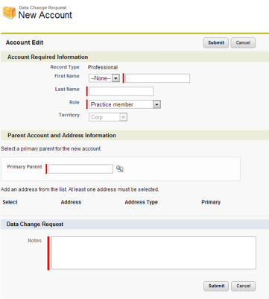
DCR-Online Process 1
Note:
  New Account DCR - Create New Account DCR via New Account Wizard

Slide 12
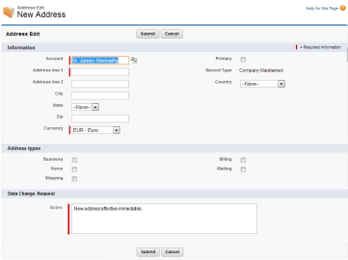
DCR - Online Process 2
New Address DCR - Create New Address DCR via New Address Wizard

Slide 13
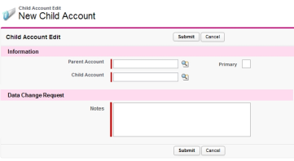
DCR - Online Process 3
New Child Account DCR - There are two ways to create a new child account:
The New Child Account button on the Person Account detail page
The New Child Account button on the Business Account detail page

Slide 14
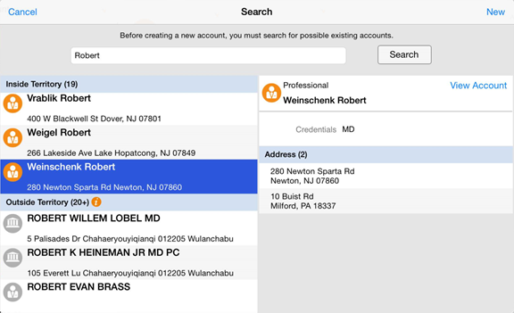
DCR - iPad Process 1
New Account DCR - Create New Account DCR via Network Account Search results page by tapping the New button

Slide 15
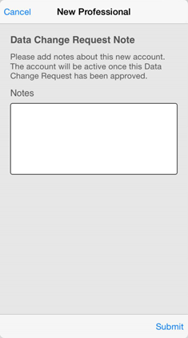
DCR - iPad Process 2
After tapping the New button, the user creates the new account using the standard procedure. After saving the changes, the DCR notes window displays

Slide 16
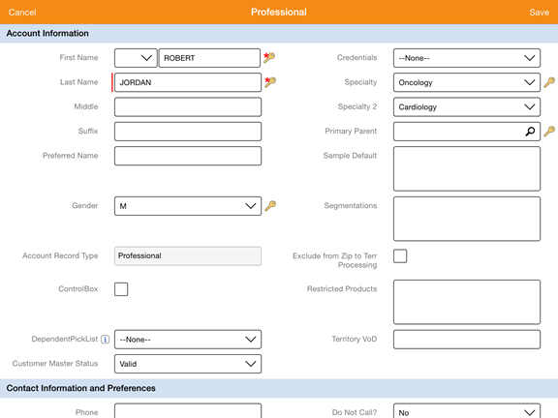
DCR - iPad Process 3
Edit Account DCR - When a user has access to the DCR object and the Account_vod record type, an Account Edit DCR page displays after the user taps the Edit button

Slide 17
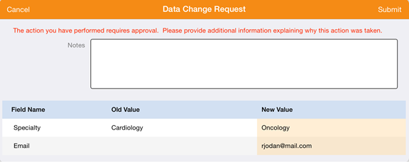
DCR - iPad Process 4
Account DCR Confirmation Page - The top section of the Data Change Request confirmation window is a Notes field (Notes_vod field of the Data Change Request object). Enter the reason for the changes or other notes for the Data Steward or equivalent responsible person. The Notes field is an optional field, but it can be made a Required field by enforcing it on the DCR page layout

Slide 18
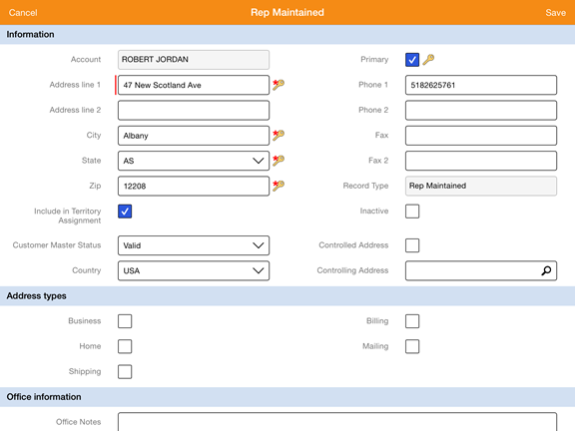
DCR - iPad Process 5
Edit Address DCR - When a user has access to the DCR object and the Address_vod record type, they can submit an Edit Address DCR. DCR-controlled fields display with a lock icon on the right side. A Data Change Request confirmation window displays when the user taps Save

Slide 19
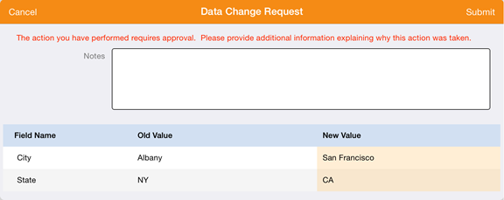
DCR - iPad Process 6
Address DCR Confirmation Page - The top section of the Data Change Request confirmation window is a Notes field (Notes_vod field of the Data Change Request object). Enter the reason for the changes or other notes for the Data Steward or equivalent responsible person. The Notes field is an optional field, but it can be made a Required field by enforcing it on the DCR page layout

Slide 20
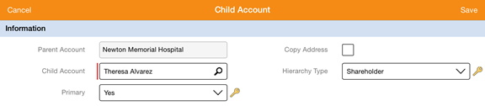
DCR - iPad Process 7
Edit Child Account DCR - When a user has access to the DCR object and the Child_Account_vod record type, they can submit an Edit Child Account DCR. DCR-controlled fields display with a lock icon on the right side. A Data Change Request confirmation window displays when the user taps Save

Slide 21
DCR – Editing DCRs
If the user opens a DCR to edit, clicks a DCR field and does not change it, a DCR is not created when you click Submit
If a DCR field is cleared (empty) and the DCR is submitted, then:
  If the DCR field is required, a standard error message displays at the top of the page and beneath the field (Error: You must enter a value)
  If the DCR field is not required, the user is allowed to clear the contents. This will result in a DCR line with (empty) as the new value for that field
A user can edit as many DCR fields as necessary before clicking Submit

Slide 22
Data Change Request
DCR Configuration
20-07-2023

Slide 23
DCR Configuration 1
To Configure a DCR: You have to follow the below Steps
Enable the Data Change Request Mode Veeva Setting with a value of 1
Provide access to the relevant DCR Record types (Account, Address or Child Account)
Provide VisualForce page access to the user profile for the following pages
  Edit_Account_DCR_vod
  Edit_Address_DCR_vod
  Edit_Child_Account_DCR_vod
  New_Address_DCR_vod
  New_Child_Account_DCR_vod
  New_Parent_Account_DCR_vod

Slide 24
DCR Configuration 2
Remove the standard SFDC 'Edit' button from page layouts that create DCRs. Replace it with the custom Edit DCR button. The custom Edit DCR button names are Edit_DCR_vod, Edit_Address_DCR_vod, and Edit_Child_Account_DCR_vod for Account, Address, and Child Account respectively

Slide 25
DCR Configuration 3
There are three DCR Objects
  Data Change Request Header
  Data Change Request Lines
  DCR Field Type
DCR Objects
Data Change Request Header
Data Change Request Lines
DCR Field Type

Slide 26
DCR Configuration 4
Data Change Request Header
User profile must have Read, Edit, and Create permissions on the Data Change Request object (Setup/Manage Users/Profiles/Data Change Requests)
Field Level Security must be set to visible for each profile (Setup/Manage Users/(Profile Name) /Field Level Security/Data Change Request/View)
Verify that a VMobile Object Configuration entry exists for the Data_Change_Request_vod__c object. If not, create a new entry and ensure the Type is set to Top Level and the Active flag is selected

Slide 27
DCR Configuration 5
Data Change Request Lines
User profile must have Edit, Read, and Create permissions on the Data Change Request Lines object (Setup/Manage Users/Profiles/Data Change Request Lines)
Field Level Security must be set to visible for each profile (Setup/Manage Users/ (Profile Name)/Field Level Security/Data Change Request Lines/View)
Verify that a VMobile Object Configuration entry exists for the Data_Change_Request_Line_vod__c object. If not, create a new entry and ensure the Type is set to Top Level and the Active flag is selected

Slide 28
DCR Configuration 6
DCR Field Type
User profile must have Read permission on the DCR Field Type object (Setup/Manage Users/Profiles/DCR Field Types)
Field Level Security must be set to visible for each profile (Setup/Manage Users/ (Profile Name)/Field Level Security/DCR Field Type/View)
Verify that a VMobile Object Configuration entry exists for the DCR_Field_Type_vod__c object. If not, create a new entry and ensure the Type is set to Top Level and the Active flag is selected

Slide 29
DCR Configuration 7
DCR Configuration for Controlled Fields
DCR Field Types tab needs to be enabled for administrators
A DCR Field Type record needs to be created for each DCR-managed field on the account, child account, or address object

Slide 30
DCR Configuration 8
Four categories of fields can be used. All the supported configurations are listed below. Configurations, other than the ones listed, are not supported
DCR_Editable_vod - Editable Network Field: Field can be modified by user. Changes trigger creation of DCR in the background
DCR_Editable_Required_vod - Editable Required Network Field: Field can be modified by user. Value cannot be empty. Changes trigger creation of DCR in the background
DCR_vod - DCR Controlled Network Field: Field cannot be modified by user. User needs to create a DCR in order to modify a field value. Changes are performed only after receiving approval from Network
DCR_Required_vod - Field cannot be modified by user. User needs to create a DCR in order to modify a field value. Changes are performed only after receiving approval from Network. Value cannot be empty when creating a DCR

Slide 31
Data Change Request
DCR Results
20-07-2023

Slide 32
DCR Results 1
DCR Results
DCRs contain header details such as the DCR type, timestamps, and other general info. A DCR Line object contains information primarily about the fields being edited and points back to the DCR Header. A DCR Header may have a number of DCR Lines pointing to it. Both the DCR Header and DCR Lines contain result information

Slide 33
DCR Results 2
Results in DCR Header
Accepted - All changes are accepted
Rejected – All changes are rejected
Partial - At least one field change was accepted (see fields for details)
Results in DCR Line
Accepted - The changes are accepted
Rejected - The changes are rejected
Modified - The change for this field is accepted with differences (modified by a data steward or administrator)
Already Applied - The change for this field is applied (another DCR was previously processed with the same change)

Slide 34
Data Change Request
Data Change Request Model
20-07-2023

Slide 35
Data Change Request Model 1
CRM
Networks
Processed
Change_ Processed
New
Submitted
Pending
Change_New
Change_PendingReview
Change_PartiallyProcessed
Cancelled
Change_Cancelled

Slide 36
Data Change Request Model 2
Unlinked Records in CRM
If a record in CRM is not linked to Network properly, for example, the record does not have a valid Network vid or no vid at all, when a user submits the DCR on that record, CRM does not attempt to send the DCR to Network. Instead, CRM does the following to optimize the process:
  The Status field of the DCR is set to Canceled
  The Result field of the DCR is set to Change Rejected
  The Error field of the DCR is set to Related record missing Network External ID: {SFID}

Slide 37
Data Change Request
Network and Data Change Request Settings Overview
20-07-2023

Slide 38
Network and DCR Settings 1
Network Settings Group
Network-specific settings are located in VEEVA. To navigate to Network Settings follow the below steps:
  Click Setup
  Click Develop
  Click Custom Settings
  Click Network Settings
Settings related to creating Data Change Requests (DCRs) are found in the VEEVA Settings group available to all CRM customers

Slide 39
Network and DCR Settings 2
High-Level Configuration for DCRs and Network
To enable a user to create DCRs, set the DATA_CHANGE_REQUEST_MODE_vod setting to 1. If this setting is 0, users cannot create DCRs regardless of other object permissions
Customers not using VEEVA Network to manage customer master data can enable this setting [DATA_CHANGE_REQUEST_MODE_vod setting to 1] to begin capturing DCRs within VEEVA. In addition to this setting, administrators need to configure object permissions for users who create DCRs and which fields generate DCRs when edited
To indicate a user as a Network Customer Master user, set the NETWORK_CUSTOMER_MASTER_MODE_vod setting to 1. If setting [DATA_CHANGE_REQUEST_MODE_vod setting to 1] is 0, DCRs for editing or creating account data are not sent to Network. If set to 1, all DCRs are sent to Network

Slide 40
Network and DCR Settings 3
The value in this setting is stamped on each DCR created by a user to ensure proper routing. The data is stored in the Network_Customer_Master_Mode_vod field on the Data_Change_Request_vod object
Additionally, the country of the user who created the DCR is stamped in the Country_Mapping_vod field on the Data_Change_Request_vod object. This is used to determine which mapping should be used when processing a DCR, which assists in handling multi-country implementations. It is required that the Admin set the Country field on the User object using the country’s 2-digit ISO 3166-1 alpha 2 code
  Note: ISO 3166-1-alpha-2 English country names and code elements. This list states the country names (official short names in English) in alphabetical order as given in ISO 3166-1 and the corresponding ISO 3166-1-alpha-2 code elements

Slide 41
Check Your Understanding ... 1
1. How many objects relevant to DCR are present in VEEVA?
1
2
3
4
Answer: 3

Slide 42
Check Your Understanding ... 2
2. What are the key fields needed to enter in VEEVA while creating a new Account DCR?
DCR Status
Notes
Name
None of the above
Answer: Notes

Slide 43
Check Your Understanding ... 3
3.Which one from following cannot be a Status of DCR?
New
Processed
Pending
Accepted
Answer: Accepted

Slide 44
Check Your Understanding ... 4
DCR process cannot be used in Third party validation services?
True
False
Answer: False

Slide 45
Check Your Understanding ... 5
How many types of Results in DCR header are present in VEEVA?
2
3
4
5
Answer: 3

Slide 46

Summary
In this module, you have learnt to:
Define the DCR process
Configure a DCR
View/Interpret the results of a DCR
Define a DCR model
Describe the Network settings for DCR

Slide 47
Source
https://crmhelp.veeva.com/doc/Content/Home.htm
Disclaimer: Parts of the content of this course is based on the materials available from the Web sites and books listed above. The materials that can be accessed from linked sites are not maintained by Cognizant Academy and we are not responsible for the contents thereof. All trademarks, service marks, and trade names in this course are the marks of the respective owner(s).

Slide 48
Coming Next ...
In the upcoming module – Coaching Reports you will learn to,
  Define Coaching Reports
  Visualize Coaching Reports
  Explain the functionality for Coaching Reports
  Configure Coaching Reports in VEEVA

Slide 49
Thank you
  You have successfully completed
  Overview of Data Change Request

